Slide 1
Software Engineering
Requirement Engineering

Slide 2
Objectives
To introduce the concepts of user and system requirements
To describe functional and non-functional requirements
To explain how software requirements may be organised in a requirements document
SRS (Software Requirement Specification Documentation)

Slide 3
Topics covered
Functional and non-functional requirements
User requirements
System requirements
Interface specification
The software requirements document

Slide 4
Requirements engineering
The process of establishing the services that the customer requires from a system and the constraints under which it operates and is developed.
The requirements themselves are the descriptions of the system services and constraints that are generated during the requirements engineering process.

Slide 5
What is a requirement?
It may range from a high-level abstract statement of a service or of a system constraint to a detailed mathematical functional specification.
Optimization of any process
This is inevitable as requirements may serve a dual function
May be the basis for a bid for a contract - therefore must be open to interpretation;
May be the basis for the contract itself - therefore must be defined in detail;
Both these statements may be called requirements.

Slide 6
Requirement Engineering
Requirements set out what the system should do and define constraints on its operation and implementation.
Functional requirements set out services the system should provide.
Non-functional requirements constrain the system being developed or the development process.
User requirements are high-level statements of what the system should do. User requirements should be written using natural language, tables and diagrams.
System requirements are intended to communicate the functions that the system should provide.
A software requirements document is an agreed statement of the system requirements.
The IEEE standard is a useful starting point for defining more detailed specific requirements standards

Slide 7
Requirements abstraction (Davis)

Slide 8
Types of requirement
User requirements
Statements in natural language plus diagrams of the services the system provides and its operational constraints. Written for customers.
System requirements
A structured document setting out detailed descriptions of the system’s functions, services and operational constraints. Defines what should be implemented so may be part of a contract between client and contractor.

Slide 9
Definitions and specifications

Slide 10
Requirements readers

Slide 11
Functional and non-functional requirements
Functional requirements
Statements of services the system should provide, how the system should react to particular inputs and how the system should behave in particular situations.
Non-functional requirements
constraints on the services or functions offered by the system such as timing constraints, constraints on the development process, standards, etc.
Domain requirements
Requirements that come from the application domain of the system and that reflect characteristics of that domain.

Slide 12
Requirement Metrix
Property | Measure
Speed | Processed transactions/second User/event response time Screen refresh time
Size | Mbytes Number of ROM chips
Ease of use | Training time Number of help frames
Reliability | Mean time to failure (MTTF) Probability of unavailability Rate of failure occurrence Availability
Robustness | Time to restart after failure (MTTR) Percentage of events causing failure Probability of data corruption on failure
Portability | Percentage of target dependent statements Number of target systems

Slide 13
Functional requirements
Describe functionality or system services.
Depend on the type of software, expected users and the type of system where the software is used.
Functional user requirements may be high-level statements of what the system should do but functional system requirements should describe the system services in detail.

Slide 14
The LIBSYS system Example
A library system that provides a single interface to a number of databases of articles in different libraries.
Users can search for, download and print these articles for personal study.

Slide 15
Examples of functional requirements
The user shall be able to search either all of the initial set of databases or select a subset from it.
The system shall provide appropriate viewers for the user to read documents in the document store.
Every order shall be allocated a unique identifier (ORDER_ID) which the user shall be able to copy to the account’s permanent storage area.

Slide 16
Requirements imprecision
Problems arise when requirements are not precisely stated.
Ambiguous requirements may be interpreted in different ways by developers and users.
Consider the term ‘appropriate viewers’
User intention - special purpose viewer for each different document type;
Developer interpretation - Provide a text viewer that shows the contents of the document.

Slide 17
Requirements completeness and consistency
In principle, requirements should be both complete and consistent.
Complete
They should include descriptions of all facilities required.
Consistent
There should be no conflicts or contradictions in the descriptions of the system facilities.
In practice, it is impossible to produce a complete and consistent requirements document.

Slide 18
Non-functional requirements
These define system properties and constraints e.g. reliability, response time and storage requirements. Constraints are I/O device capability, system representations, etc.
Process requirements may also be specified mandating a particular CASE system,
programming language or development method.
Non-functional requirements may be more critical than functional requirements. If these are not met, the system is useless.

Slide 19
Non-functional classifications
Product requirements
Requirements which specify that the delivered product must behave in a particular way e.g. execution speed, reliability, etc.
Organisational requirements
Requirements which are a consequence of organisational policies and procedures e.g. process standards used, implementation requirements, etc.
External requirements
Requirements which arise from factors which are external to the system and its development process e.g. interoperability requirements, legislative requirements, etc.

Slide 20
Non-functional requirement types

Slide 21
Non-functional requirements examples
Product requirement
The user interface for LIBSYS shall be implemented as simple HTML without frames or Java applets.
Organisational requirement
The system development process and deliverable documents shall conform to the process and deliverables defined in XYZCo-SP-STAN-95.
External requirement
The system shall not disclose any personal information about customers apart from their name and reference number to the operators of the system.

Slide 22
Goals and requirements
Non-functional requirements may be very difficult to state precisely and imprecise requirements may be difficult to verify.
Goal
A general intention of the user such as ease of use.
Verifiable non-functional requirement
A statement using some measure that can be objectively tested.
Goals are helpful to developers as they convey the intentions of the system users.

Slide 23
Examples
A system goal
The system should be easy to use by experienced controllers and should be organised in such a way that user errors are minimised.
A verifiable non-functional requirement
Experienced controllers shall be able to use all the system functions after a total of two hours training. After this training, the average number of errors made by experienced users shall not exceed two per day.

Slide 24
Requirements measures

Slide 25
Requirements interaction
Conflicts between different non-functional requirements are common in complex systems.
Spacecraft system
To minimise weight, the number of separate chips in the system should be minimised.
To minimise power consumption, lower power chips should be used.
However, using low power chips may mean that more chips have to be used. Which is the most critical requirement?

Slide 26
Domain requirements
Derived from the application domain and describe system characteristics and features that reflect the domain.
Domain requirements be new functional requirements, constraints on existing requirements or define specific computations.
If domain requirements are not satisfied, the system may be unworkable.

Slide 27
Library system domain requirements
There shall be a standard user interface to all databases which shall be based on the Z39.50 standard.
Because of copyright restrictions, some documents must be deleted immediately on arrival. Depending on the user’s requirements, these documents will either be printed locally on the system server for manually forwarding to the user or routed to a network printer.

Slide 28
Domain requirements problems
Understand-ability
Requirements are expressed in the language of the application domain;
This is often not understood by software engineers developing the system.
Implicitness
Domain specialists understand the area so well that they do not think of making the domain requirements explicit.

Slide 29
User requirements
Should describe functional and non-functional requirements in such a way that they are understandable by system users who don’t have detailed technical knowledge.
User requirements are defined using natural language, tables and diagrams as these can be understood by all users.

Slide 30
Problems with natural language
Lack of clarity
Precision is difficult without making the document difficult to read.
Requirements confusion
Functional and non-functional requirements tend to be mixed-up.
Requirements amalgamation
Several different requirements may be expressed together.

Slide 31
LIBSYS requirement
LIBSYS shall provide a financial accounting system that maintains records of all payments made by users of the system. System managers may configure this system so that regular users may receive discounted rates.

Slide 32
Editor grid requirement
To assist in the positioning of entities on a diagram, the user may turn on a grid in either centimetres or inches, via an option on the control panel. Initially, the grid is off. The grid may be turned on and off at any time during an editing session and can be toggled between inches and centimetres at any time. A grid option will be provided on the reduce-to-fit view but the number of grid lines shown will be reduced to avoid filling the smaller diagram with grid lines.

Slide 33
Requirement problems
Database requirements includes both conceptual and detailed information
Describes the concept of a financial accounting system that is to be included in LIBSYS;
However, it also includes the detail that managers can configure this system - this is unnecessary at this level.
Grid requirement mixes three different kinds of requirement
Conceptual functional requirement (the need for a grid);
Non-functional requirement (grid units);
Non-functional UI requirement (grid switching).

Slide 34
Structured presentation

Slide 35
Guidelines for writing requirements
Invent a standard format and use it for all requirements.
Use language in a consistent way. Use shall for mandatory requirements, should for desirable requirements.
Use text highlighting to identify key parts of the requirement.
Avoid the use of computer jargon.

Slide 36
System requirements
More detailed specifications of system functions, services and constraints than user requirements.
They are intended to be a basis for designing the system.
They may be incorporated into the system contract.
System requirements may be defined or illustrated using system models discussed in Chapter 8.

Slide 37
Requirements and design
In principle, requirements should state what the system should do and the design should describe how it does this.
In practice, requirements and design are inseparable
A system architecture may be designed to structure the requirements;
The system may inter-operate with other systems that generate design requirements;
The use of a specific design may be a domain requirement.

Slide 38
Problems with NL specification
Ambiguity
The readers and writers of the requirement must interpret the same words in the same way. NL is naturally ambiguous so this is very difficult.
Over-flexibility
The same thing may be said in a number of different ways in the specification.
Lack of modularisation
NL structures are inadequate to structure system requirements.

Slide 39
Alternatives to NL specification

Slide 40
Structured language specifications
The freedom of the requirements writer is limited by a predefined template for requirements.
All requirements are written in a standard way.
The terminology used in the description may be limited.
The advantage is that the most of the expressiveness of natural language is maintained but a degree of uniformity is imposed on the specification.

Slide 41
Form-based specifications
Definition of the function or entity.
Description of inputs and where they come from.
Description of outputs and where they go to.
Indication of other entities required.
Pre and post conditions (if appropriate).
The side effects (if any) of the function.

Slide 42
Form-based node specification

Slide 43
Tabular specification
Used to supplement natural language.
Particularly useful when you have to define a number of possible alternative courses of action.

Slide 44
Tabular specification

Slide 45
Graphical models
Graphical models are most useful when you need to show how state changes or where you need to describe a sequence of actions.
Different graphical models are explained in Chapter 8.

Slide 46
Sequence diagrams
These show the sequence of events that take place during some user interaction with a system.
You read them from top to bottom to see the order of the actions that take place.
Cash withdrawal from an ATM
Validate card;
Handle request;
Complete transaction.

Slide 47
Sequence diagram of ATM withdrawal

Slide 48
Interface specification
Most systems must operate with other systems and the operating interfaces must be specified as part of the requirements.
Three types of interface may have to be defined
Procedural interfaces;
Data structures that are exchanged;
Data representations.
Formal notations are an effective technique for interface specification.

Slide 49
PDL interface description

Slide 50
The requirements document
The requirements document is the official statement of what is required of the system developers.
Should include both a definition of user requirements and a specification of the system requirements.
It is NOT a design document. As far as possible, it should set of WHAT the system should do rather than HOW it should do it

Slide 51
Users of a requirements document

Slide 52
IEEE requirements standard
Defines a generic structure for a requirements document that must be instantiated for each specific system.
Introduction.
General description.
Specific requirements.
Appendices.
Index.

Slide 53
Requirements document structure
Preface
Introduction
Glossary
User requirements definition
System architecture
System requirements specification
System models
System evolution
Appendices
Index

Slide 54
Requirements engineering processes
The processes used for RE vary widely depending on the application domain, the people involved and the organisation developing the requirements
However, there are a number of generic activities common to all processes
Requirements elicitation
Requirements analysis
Requirements validation
Requirements management

Slide 55
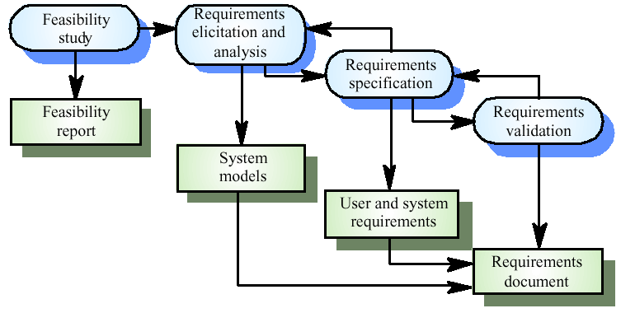
The requirements engineering process

Slide 56
Feasibility studies
A feasibility study decides whether or not the proposed system is worthwhile
A short focused study that checks
If the system contributes to organisational objectives
If the system can be engineered using current technology and within budget
If the system can be integrated with other systems that are used

Slide 57
Feasibility study implementation
Based on information assessment (what is required), information collection and report writing
Questions for people in the organisation
What if the system wasn’t implemented?
What are current process problems?
How will the proposed system help?
What will be the integration problems?
Is new technology needed? What skills?
What facilities must be supported by the proposed system?

Slide 58
Elicitation and analysis
Sometimes called requirements elicitation or requirements discovery
Involves technical staff working with customers to find out about the application domain, the services that the system should provide and the system’s operational constraints
May involve end-users, managers, engineers involved in maintenance, domain experts, trade unions, etc. These are called stakeholders

Slide 59
Problems of requirements analysis
Stakeholders don’t know what they really want
Stakeholders express requirements in their own terms
Different stakeholders may have conflicting requirements
Organisational and political factors may influence the system requirements
The requirements change during the analysis process. New stakeholders may emerge and the business environment change

Slide 60
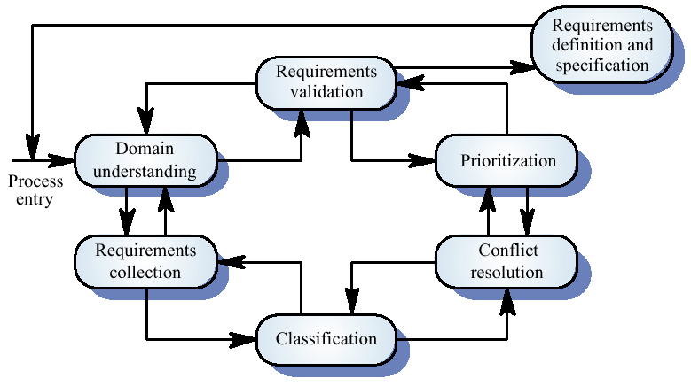
The requirements analysis process

Slide 61
Process activities
Domain understanding
Requirements collection
Classification
Conflict resolution
Prioritisation
Requirements checking

Slide 62
System models
Different models may be produced during the requirements analysis activity
Requirements analysis may involve three structuring activities which result in these different models
Partitioning. Identifies the structural (part-of) relationships between entities
Abstraction. Identifies generalities among entities
Projection. Identifies different ways of looking at a problem

Slide 63
Viewpoint-oriented elicitation
Stakeholders represent different ways of looking at a problem or problem viewpoints
This multi-perspective analysis is important as there is no single correct way to analyse system requirements

Slide 64
Banking ATM system
The example used here is an auto-teller system which provides some automated banking services
I use a very simplified system which offers some services to customers of the bank who own the system and a narrower range of services to other customers
Services include cash withdrawal, message passing (send a message to request a service), ordering a statement and transferring funds

Slide 65
Autoteller viewpoints
Bank customers
Representatives of other banks
Hardware and software maintenance engineers
Marketing department
Bank managers and counter staff
Database administrators and security staff
Communications engineers
Personnel department

Slide 66
Types of viewpoint
Data sources or sinks
Viewpoints are responsible for producing or consuming data. Analysis involves checking that data is produced and consumed and that assumptions about the source and sink of data are valid
Representation frameworks
Viewpoints represent particular types of system model. These may be compared to discover requirements that would be missed using a single representation. Particularly suitable for real-time systems
Receivers of services
Viewpoints are external to the system and receive services from it. Most suited to interactive systems

Slide 67
External viewpoints
Natural to think of end-users as receivers of system services
Viewpoints are a natural way to structure requirements elicitation
It is relatively easy to decide if a viewpoint is valid
Viewpoints and services may be sued to structure non-functional requirements

Slide 68
Method-based analysis
Widely used approach to requirements analysis. Depends on the application of a structured method to understand the system
Methods have different emphases. Some are designed for requirements elicitation, others are close to design methods
A viewpoint-oriented method (VORD) is used as an example here. It also illustrates the use of viewpoints

Slide 69
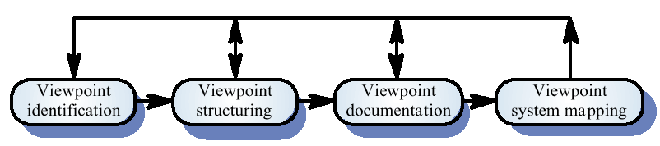
The VORD method

Slide 70
VORD process model
Viewpoint identification
Discover viewpoints which receive system services and identify the services provided to each viewpoint
Viewpoint structuring
Group related viewpoints into a hierarchy. Common services are provided at higher-levels in the hierarchy
Viewpoint documentation
Refine the description of the identified viewpoints and services
Viewpoint-system mapping
Transform the analysis to an object-oriented design

Slide 71
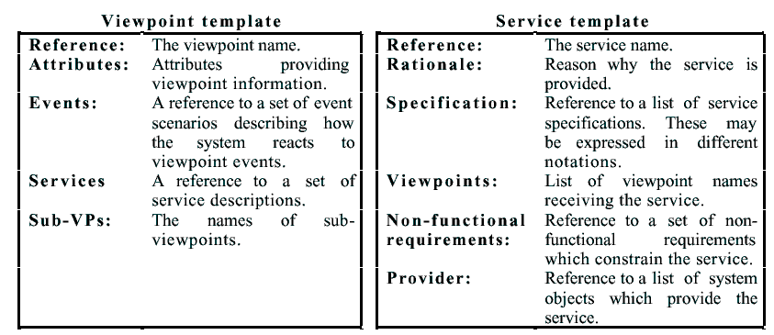
VORD standard forms

Slide 72
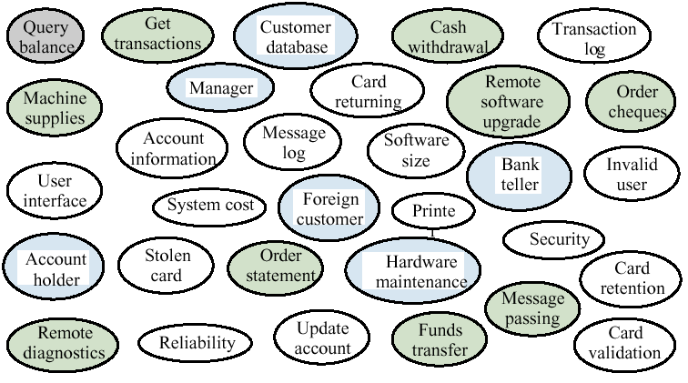
Viewpoint identification

Slide 73
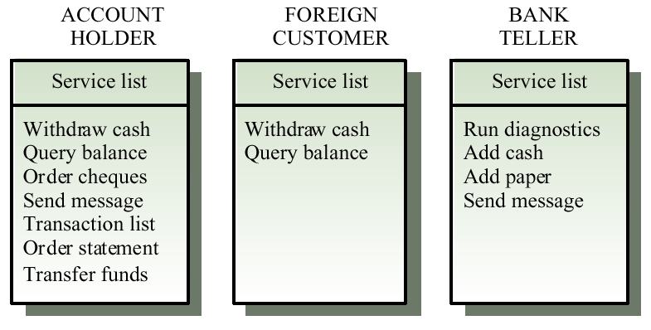
Viewpoint service information

Slide 74
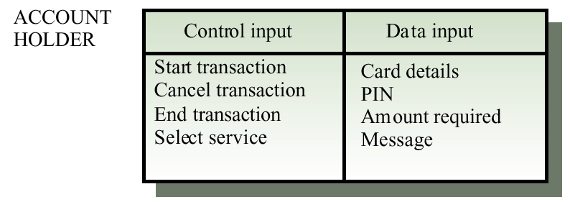
Viewpoint data/control

Slide 75
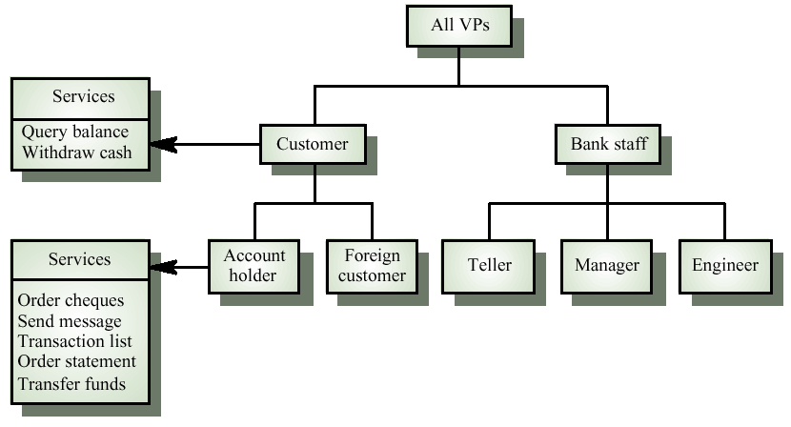
Viewpoint hierarchy

Slide 76
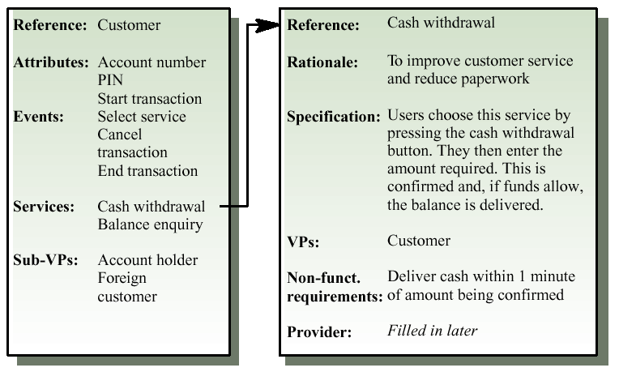
Customer/cash withdrawal templates

Slide 77
Scenarios
Scenarios are descriptions of how a system is used in practice
They are helpful in requirements elicitation as people can relate to these more readily than abstract statement of what they require from a system
Scenarios are particularly useful for adding detail to an outline requirements description

Slide 78
Scenario descriptions
System state at the beginning of the scenario
Normal flow of events in the scenario
What can go wrong and how this is handled
Other concurrent activities
System state on completion of the scenario

Slide 79
Event scenarios
Event scenarios may be used to describe how a system responds to the occurrence of some particular event such as ‘start transaction’
VORD includes a diagrammatic convention for event scenarios.
Data provided and delivered
Control information
Exception processing
The next expected event

Slide 80
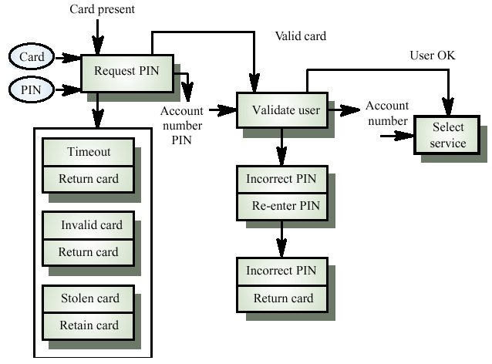
Event scenario - start transaction

Slide 81
Notation for data and control analysis
Ellipses. data provided from or delivered to a viewpoint
Control information enters and leaves at the top of each box
Data leaves from the right of each box
Exceptions are shown at the bottom of each box
Name of next event is in box with thick edges

Slide 82
Exception description
Most methods do not include facilities for describing exceptions
In this example, exceptions are
Timeout. Customer fails to enter a PIN within the allowed time limit
Invalid card. The card is not recognised and is returned
Stolen card. The card has been registered as stolen and is retained by the machine

Slide 83
Use cases
Use-cases are a scenario based technique in the UML which identify the actors in an interaction and which describe the interaction itself
A set of use cases should describe all possible interactions with the system
Sequence diagrams may be used to add detail to use-cases by showing the sequence of event processing in the system

Slide 84
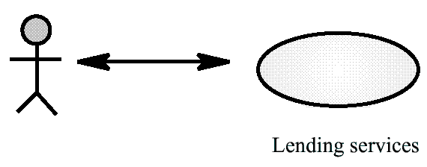
Lending use-case

Slide 85
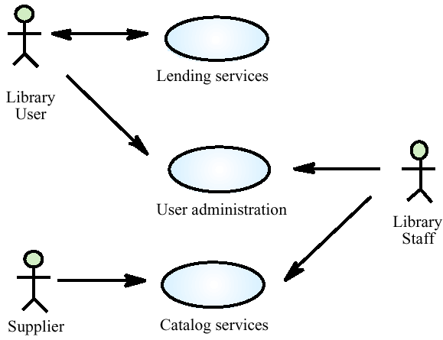
Library use-cases

Slide 86
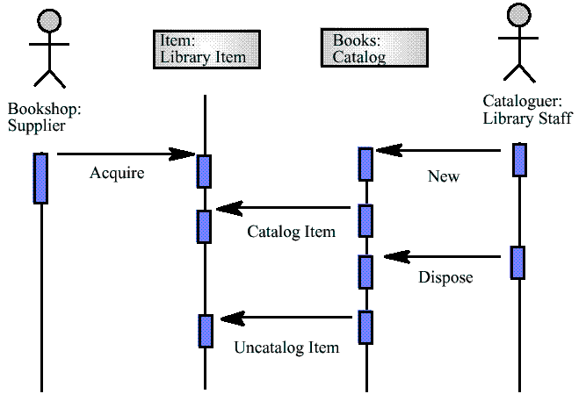
Catalogue management

Slide 87
Social and organisational factors
Software systems are used in a social and organisational context. This can influence or even dominate the system requirements
Social and organisational factors are not a single viewpoint but are influences on all viewpoints
Good analysts must be sensitive to these factors but currently no systematic way to tackle their analysis

Slide 88
Example
Consider a system which allows senior management to access information without going through middle managers
Managerial status. Senior managers may feel that they are too important to use a keyboard. This may limit the type of system interface used
Managerial responsibilities. Managers may have no uninterrupted time where they can learn to use the system
Organisational resistance. Middle managers who will be made redundant may deliberately provide misleading or incomplete information so that the system will fail

Slide 89
Ethnography
A social scientists spends a considerable time observing and analysing how people actually work
People do not have to explain or articulate their work
Social and organisational factors of importance may be observed
Ethnographic studies have shown that work is usually richer and more complex than suggested by simple system models

Slide 90
Focused ethnography
Developed in a project studying the air traffic control process
Combines ethnography with prototyping
Prototype development results in unanswered questions which focus the ethnographic analysis
Problem with ethnography is that it studies existing practices which may have some historical basis which is no longer relevant

Slide 91
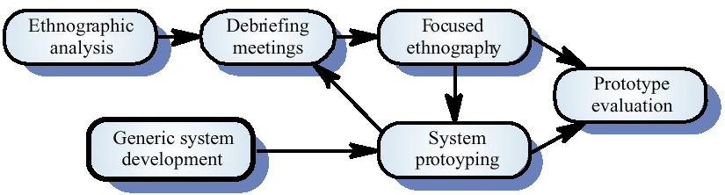
Ethnography and prototyping

Slide 92
Scope of ethnography
Requirements that are derived from the way that people actually work rather than the way I which process definitions suggest that they ought to work
Requirements that are derived from cooperation and awareness of other people’s activities

Slide 93
Requirements validation
Concerned with demonstrating that the requirements define the system that the customer really wants
Requirements error costs are high so validation is very important
Fixing a requirements error after delivery may cost up to 100 times the cost of fixing an implementation error

Slide 94
Requirements checking
Validity. Does the system provide the functions which best support the customer’s needs?
Consistency. Are there any requirements conflicts?
Completeness. Are all functions required by the customer included?
Realism. Can the requirements be implemented given available budget and technology
Verifiability. Can the requirements be checked?

Slide 95
Requirements validation techniques
Requirements reviews
Systematic manual analysis of the requirements
Prototyping
Using an executable model of the system to check requirements. Covered in Chapter 8
Test-case generation
Developing tests for requirements to check testability
Automated consistency analysis
Checking the consistency of a structured requirements description

Slide 96
Requirements reviews
Regular reviews should be held while the requirements definition is being formulated
Both client and contractor staff should be involved in reviews
Reviews may be formal (with completed documents) or informal. Good communications between developers, customers and users can resolve problems at an early stage

Slide 97
Review checks
Verifiability. Is the requirement realistically testable?
Comprehensibility. Is the requirement properly understood?
Traceability. Is the origin of the requirement clearly stated?
Adaptability. Can the requirement be changed without a large impact on other requirements?

Slide 98
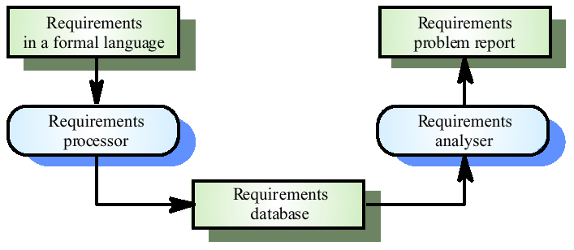
Automated consistency checking

Slide 99
Requirements management
Requirements management is the process of managing changing requirements during the requirements engineering process and system development
Requirements are inevitably incomplete and inconsistent
New requirements emerge during the process as business needs change and a better understanding of the system is developed
Different viewpoints have different requirements and these are often contradictory

Slide 100
Requirements change
The priority of requirements from different viewpoints changes during the development process
System customers may specify requirements from a business perspective that conflict with end-user requirements
The business and technical environment of the system changes during its development

Slide 101
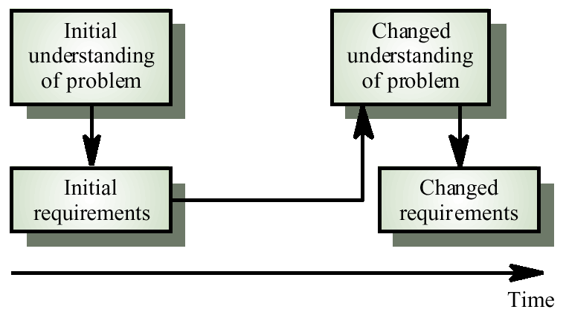
Requirements evolution

Slide 102
Enduring and volatile requirements
Enduring requirements. Stable requirements derived from the core activity of the customer organisation. E.g. a hospital will always have doctors, nurses, etc. May be derived from domain models
Volatile requirements. Requirements which change during development or when the system is in use. In a hospital, requirements derived from health-care policy

Slide 103
Classification of requirements
Mutable requirements
Requirements that change due to the system’s environment
Emergent requirements
Requirements that emerge as understanding of the system develops
Consequential requirements
Requirements that result from the introduction of the computer system
Compatibility requirements
Requirements that depend on other systems or organisational processes

Slide 104
Requirements management planning
During the requirements engineering process, you have to plan:
Requirements identification
How requirements are individually identified
A change management process
The process followed when analysing a requirements change
Traceability policies
The amount of information about requirements relationships that is maintained
CASE tool support
The tool support required to help manage requirements change

Slide 105
Traceability
Traceability is concerned with the relationships between requirements, their sources and the system design
Source traceability
Links from requirements to stakeholders who proposed these requirements
Requirements traceability
Links between dependent requirements
Design traceability
Links from the requirements to the design

Slide 106
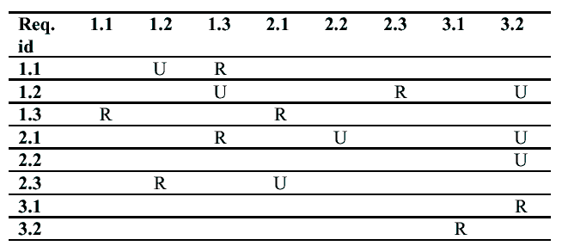
A traceability matrix

Slide 107
CASE tool support
Requirements storage
Requirements should be managed in a secure, managed data store
Change management
The process of change management is a workflow process whose stages can be defined and information flow between these stages partially automated
Traceability management
Automated retrieval of the links between requirements

Slide 108
Requirements change management
Should apply to all proposed changes to the requirements
Principal stages
Problem analysis. Discuss requirements problem and propose change
Change analysis and costing. Assess effects of change on other requirements
Change implementation. Modify requirements document and other documents to reflect change

Slide 109
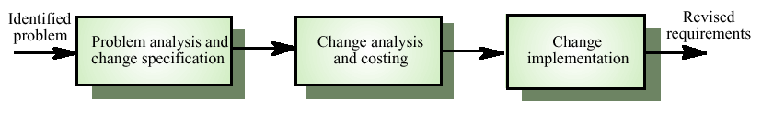
Requirements change management

